Slide 1
Web Fundamentals Project

Slide 2
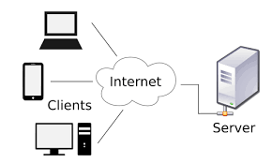
How does the web work?
How does the web work?
Web servers and web browsers communicate via HTTP
HTTP ensures that all parts of the web page are delivered
Web browser decides how these items are displayed
The backbone of the web is the network of webservers across the world. These are really just computers that have a particular type of software running on them - software that knows how to speak the HTTP protocol and knows which information stored on the computer should be made accessible through the web.

Slide 3
What do you need to be a web developer?
The 5 simple steps you need to be a web developer
1 *Learn web development fundamentals
2 *Choose a development specialization
3 *Learn key programming languages for web development
4 *Work on projects to develop your Web Developer skills
5 *Build your portfolio

Slide 4
Why did I choose to learn to develop the web?
If everyone relied on someone else to build a website, there would be no one to build a website.
Otherwise, because it’s a way to earn income while working alone, working from a coffee shop, and working on your own schedule. It’s also intellectually stimulating for introverts like me, and helps us remain anxiety-free.
Also, website development is a field where the technology constantly changes. Intellectuals generally desire living in a constant state of knowledge consumption.

